Slide 1
Inheritance Basics
Inheritance allows programmer to define a general class
Later you define a more specific class
  Adds new details to general definition
New class inherits all properties of initial, general class

Slide 2
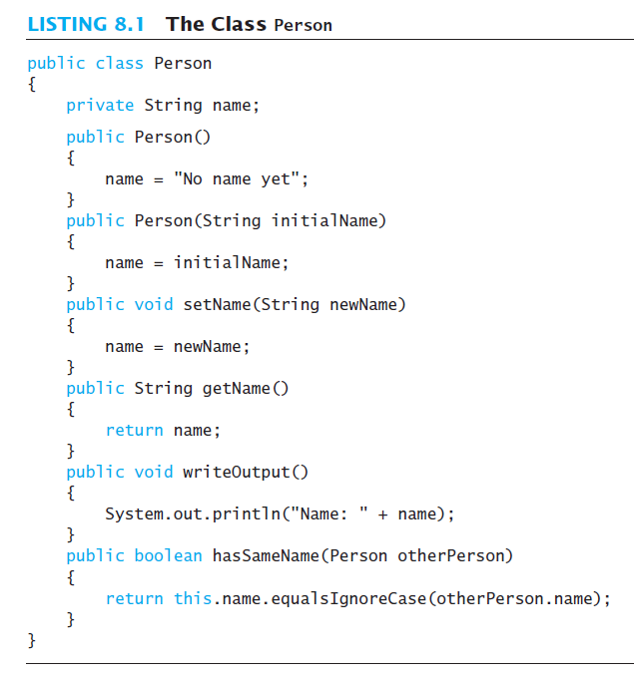
Inheritance

Slide 3
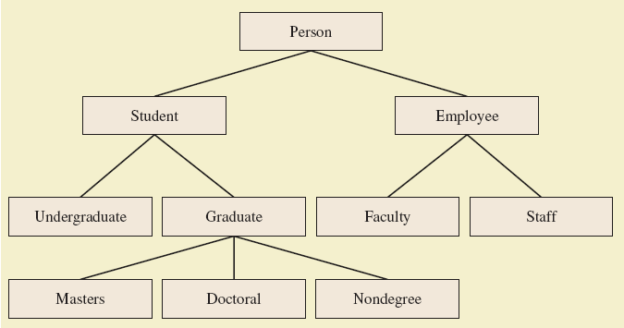
Derived Classes
A class hierarchy

Slide 4
Derived Classes
Class Person used as a base class
  Also called superclass
Now we declare derived class Student
  Also called subclass
  Inherits methods from the superclass
derived class - example
class Student extends Person

Slide 5
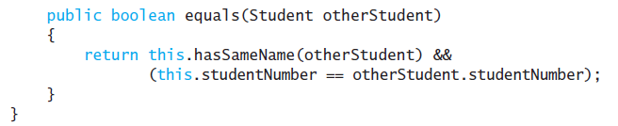
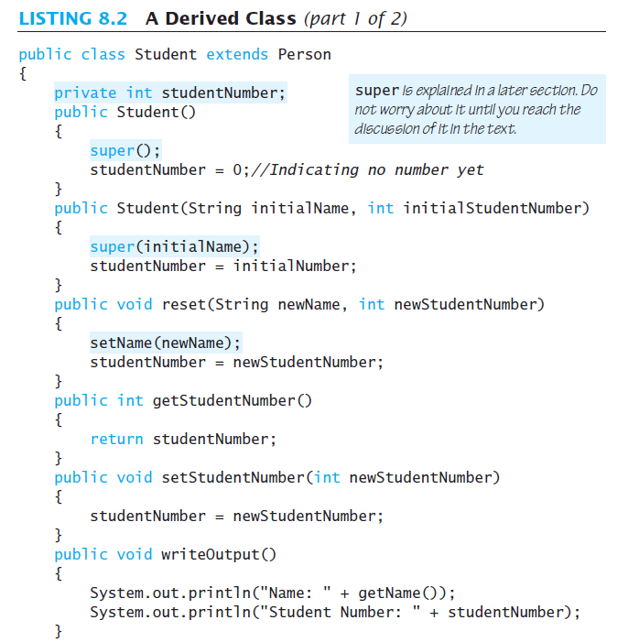
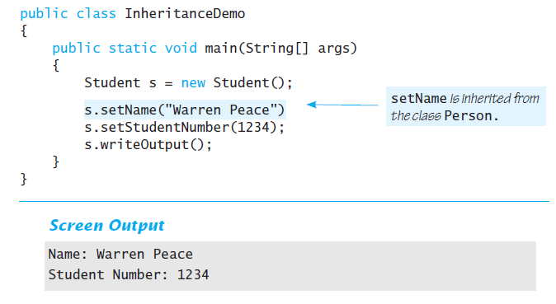
Derived Classes

Slide 6
Overriding Method Definitions
Note method writeOutput in class Student
  Class Person also has method with that name
Method in subclass with same signature overrides method from base class
  Overriding method is the one used for objects of the derived class
Overriding method must return same type of value

Slide 7
Overriding Versus Overloading
Do not confuse overriding with overloading
  Overriding takes place in subclass – new method with same signature
Overloading
  New method in same class with different signature

Slide 8
The final Modifier
Possible to specify that a method cannot be overridden in subclass
Add modifier final to the heading
public final void specialMethod()
An entire class may be declared final
  Thus cannot be used as a base class to derive any other class

Slide 9
Private Instance Variables, Methods
Consider private instance variable in a base class
  It is not inherited in subclass
  It can be manipulated only by public accessor, modifier methods
Similarly, private methods in a superclass not inherited by subclass

Slide 10
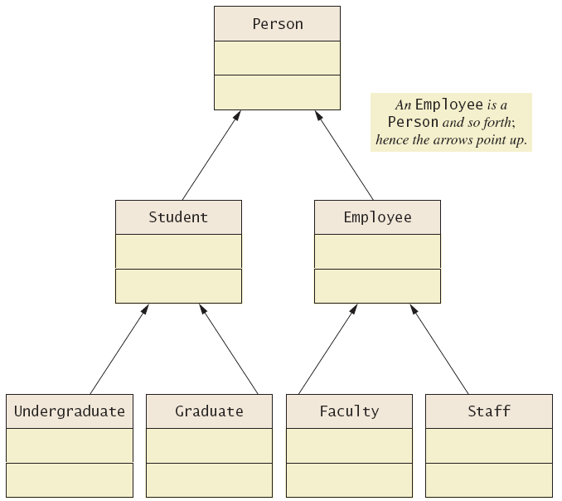
UML Inheritance Diagrams
A class hierarchy in UML notation

Slide 11
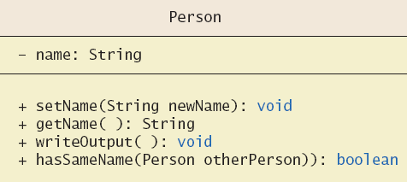
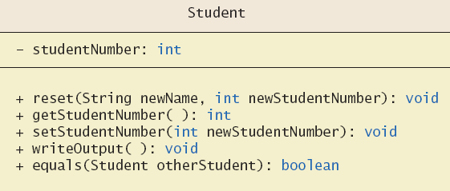
UML Inheritance Diagrams
Some details of UML class
hierarchy

Slide 12
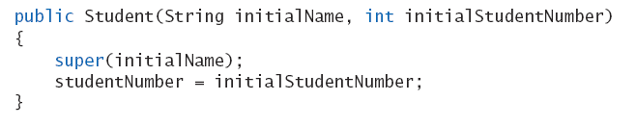
Constructors in Derived Classes
A derived class does not inherit constructors from base class
  Constructor in a subclass must invoke constructor from base class
Use the reserve word super
  Must be first action in the constructor

Slide 13

The this Method – Again
Also possible to use the this keyword
  Use to call any constructor in the class
When used in a constructor, this calls constructor in same class
  Contrast use of super which invokes constructor of base class

Slide 14
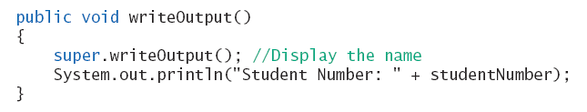
Calling an Overridden Method
Reserved word super can also be used to call method in overridden method
Calls method by same name in base class

Slide 15
Programming Example
A derived class of a derived class
class Undergraduate
Has all public members of both
  Person
  Student
This reuses the code in superclasses

Slide 16
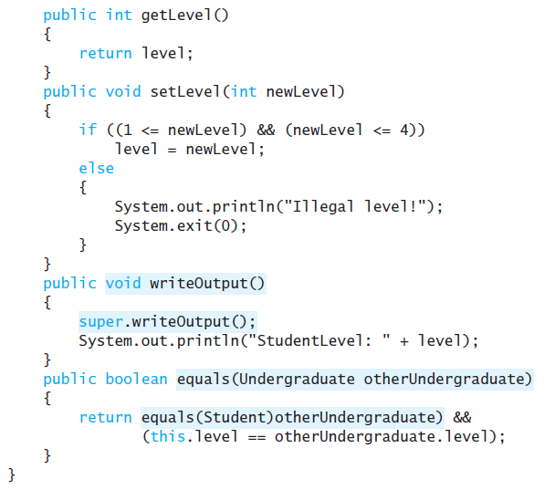
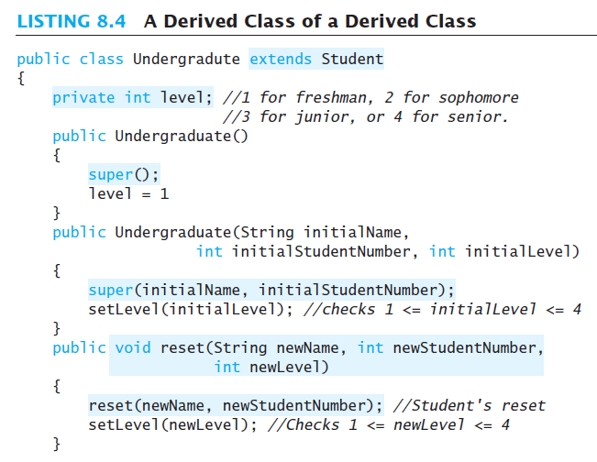
Programming Example

Slide 17
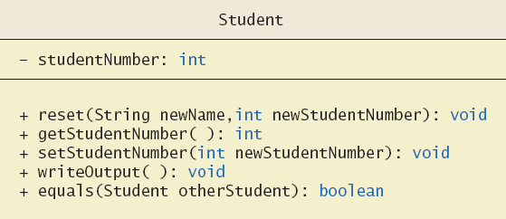
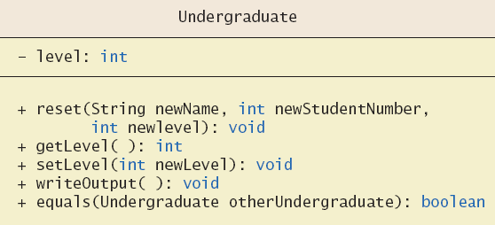
Programming Example
More details
of the UML
class
hierarchy

Slide 18
Type Compatibility
In the class hierarchy
  Each Undergraduate is also a Student
  Each Student is also a Person
An object of a derived class can serve as an object of the base class
  Note this is not typecasting
An object of a class can be referenced by a variable of an ancestor type

Slide 19
Type Compatibility
Be aware of the "is-a" relationship
  A Student is a Person
Another relationship is the "has-a"
  A class can contain (as an instance variable) an object of another type
  If we specify a date of birth variable for Person – it "has-a" Date object

Slide 20
The Class Object
Java has a class that is the ultimate ancestor of every class
  The class Object
Thus possible to write a method with parameter of type Object
  Actual parameter in the call can be object of any type
Example: method
println(Object theObject)

Slide 21
The Class Object
Class Object has some methods that every Java class inherits
Examples
  Method equals
  Method toString
Method toString called when println(theObject) invoked
  Best to define your own toString to handle this

Slide 22
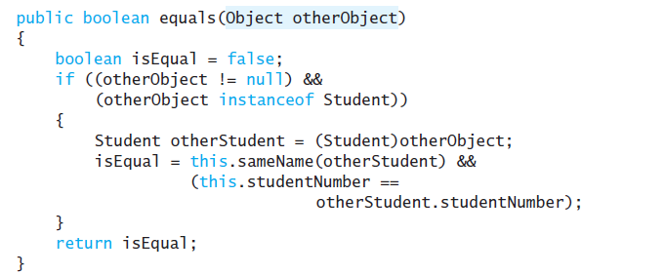
A Better equals Method
Programmer of a class should override method equals from Object
View code of sample override
public boolean equals
(Object theObject)

